Slide 1
Automatic Camera Calibration Using Pattern Detection for Vision-Based Machine learning
NAME:ANANTHI
ENROLL NO:EBEON0322582149
BATCH NO:7252

Slide 2
Introduction
Traffic parameters such as volume, speed, and vehicle classification are fundamental for…
Traffic impacts of land use
Traffic engineering applications
Intelligent Transportation Systems (ITS)
Transportation planning
Notes:
Signal timing, geometric designs
Capacity analysis and road design

Slide 3
Collecting traffic parameters
Different types of sensors can be used to gather data:
Inductive loop detectors and magnetometers
Radar or laser based sensors
Piezos and road tube sensors
Problems with these traditional sensors
Data quality deteriorates as highways reach capacity
Inductive loop detectors can join vehicles
Piezos and road tubes can miscalculate spacing
Motorcycles are difficult to count regardless of traffic
Notes:
Multiple sensors, traffic disruption

Slide 4
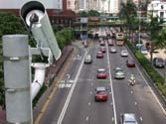
Machine vision sensors
Proven technology
Capable of collecting speed, volume, and classification
Several commercially available systems
Uses virtual detection
Benefits of video detection
No traffic disruption for installation
and maintenance
Covers wide area with a single camera
Provides rich visual information for
manual inspection

Slide 5
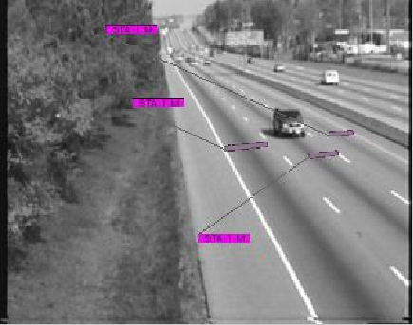
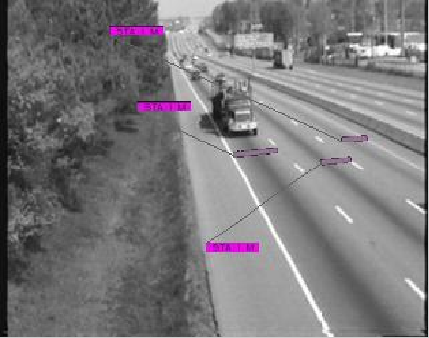
Why tracking?
Current systems use localized detection within the detection zones
which can be prone to errors when camera placement in not ideal.
Tracking enables prediction of a vehicle’s location in consecutive frames
Can provide more accurate estimates of traffic volumes and speeds
Potential to count turn-movements at intersections
Detect traffic incidents

Slide 6
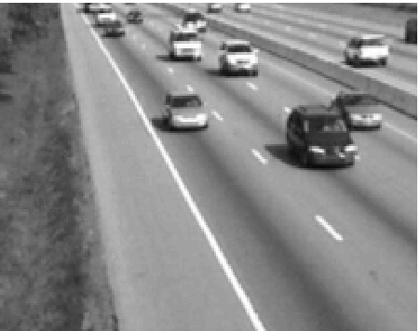
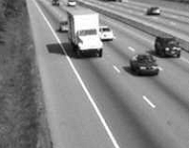


Initialization problem
Partially occluded vehicles appear as a single blob
Contour and blob tracking methods assume isolated initialization
Depth ambiguity makes the problem harder

Slide 7
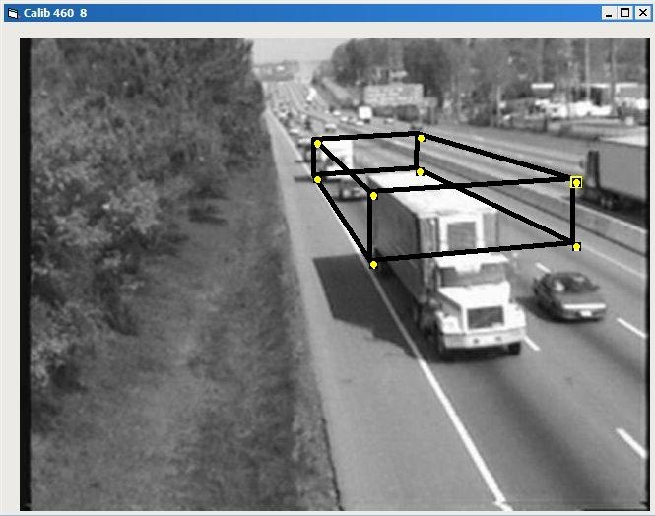
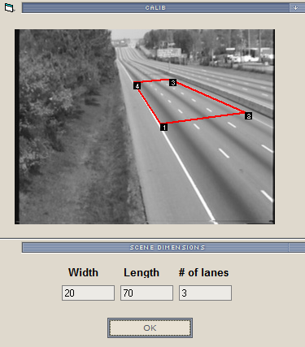
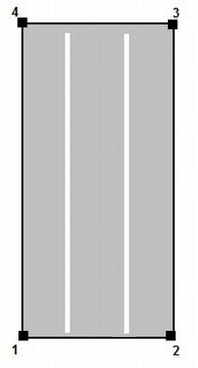
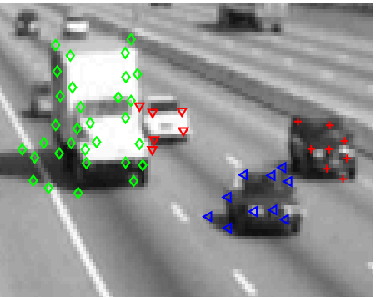
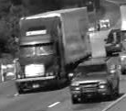
Our previous work
Feature segmentation
Vehicle Base Fronts

Slide 8
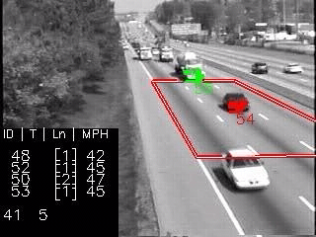
Results of feature-tracking
Notes:
Show l1-dense sequence

Slide 9
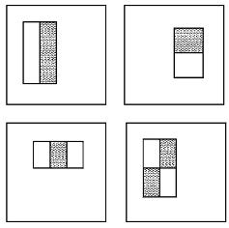




Pattern recognition for video detection
Stage 1
Stage 2
Stage 3
Detection
Rejected sub-windows
Viola and Jones, “Rapid object detection using a boosted cascade of simple features”,
CVPR 2019

Slide 10
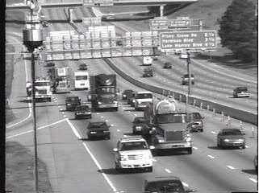
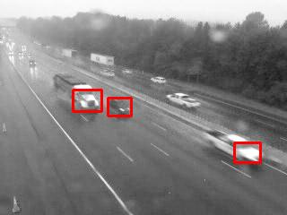
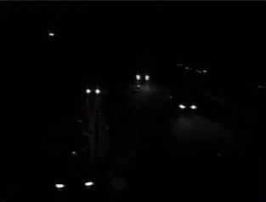
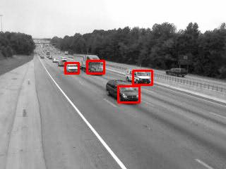
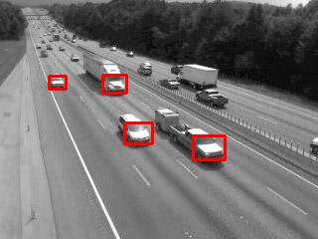
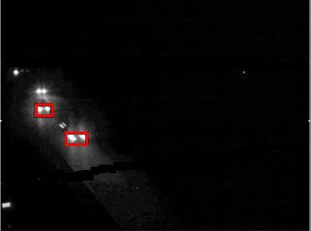
Boosted cascade vehicle detector
Calibration not required for counts
Immune to shadows and headlight reflections
Helps in vehicle classification
Notes:
Add references

Slide 11
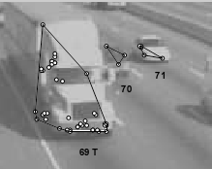

Need for pattern detection
Feature segmentation
Pattern detection
Works under varying camera
placement
Needs a trained detector for
Significantly different viewpoints
Eliminates false counts due to shadows but headlight reflections are still a problem
Does not get distracted by headlight reflections
Handles lateral occlusions but fails in case of back-to-back occlusions
Handles back-to-back occlusions but difficult to handle lateral occlusions

Slide 12
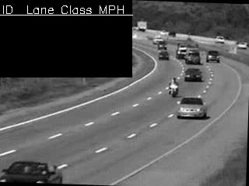
Pattern detection based tracking

Slide 13
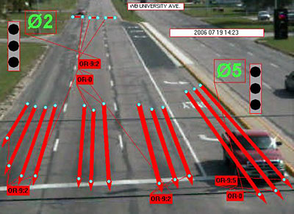
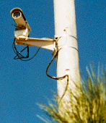
Why automatic calibration?
Fixed view camera
Manual set-up
PTZ Camera

Slide 14
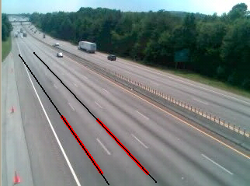
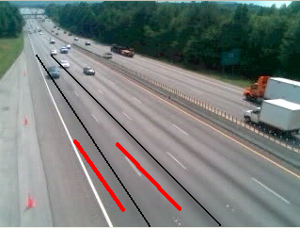
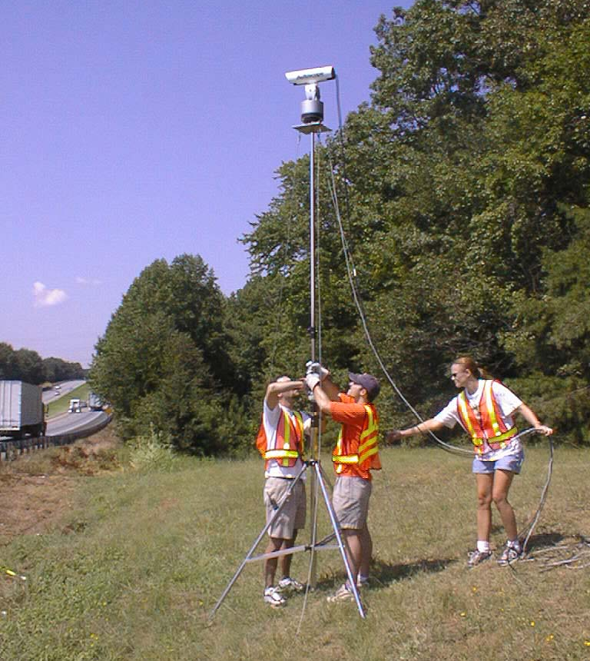
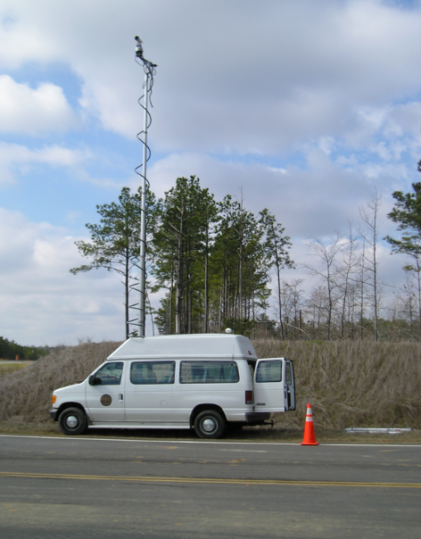
Why automatic calibration?
PTZ

Slide 15
Calibration approaches
Image-world correspondences
f, h, Φ, θ …
M_{[3x4]}
M_{[3x4]}
Direct estimation of
projective transform
Estimation of parameters for the assumed camera model
Goal is to estimate 11 elements of a matrix which transforms points in 3D to a 2D plane
Harder to incorporate scene-specific knowledge
Goal is to estimate camera parameters such as focal length and pose
Easier to incorporate known quantities and constraints

Slide 16
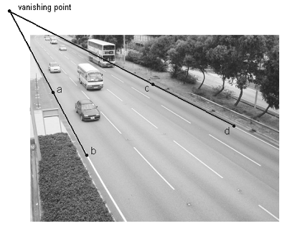
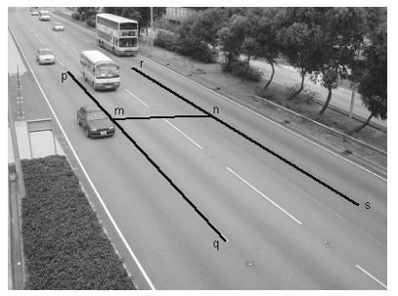
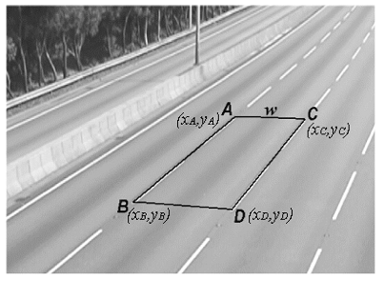
Manual calibration
Kanhere et al. (2006)
Bas and Crisman (1997)
Lai (2000)
Fung et al. (2003)

Slide 17
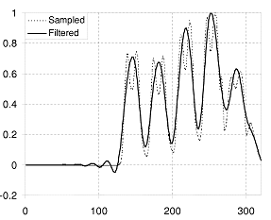
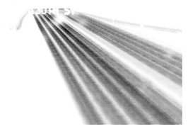
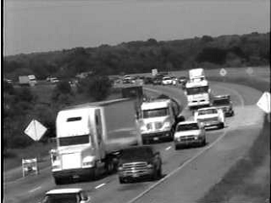
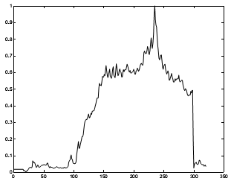
Automatic calibration
Schoepflin and Dailey (2003)
Song et al. (2006)
Known camera height
Needs background image
Depends on detecting road markings
Lane activity map
Peaks at lane centers
Dailey et al. (2000)
Avoids calculating camera
Parameters
Based on assumptions that reduce the problem to 1-D
geometry
Uses parameters from the
distribution of vehicle lengths.
Uses two vanishing points
Lane activity map sensitive of spill-over
Correction of lane activity map needs background image
Notes:
Common to all: Do not work in night time

Slide 18
Our approach to automatic calibration
Input frame
Input frame
Input frame
Input frame
Yes
strong
Yes
strong
strong
BCVD
strong
BCVD
gradients?
gradients?
gradients?
gradients?
detections
detections
VP
VP
-
-
1
VP
2
VP
-
-
0
1
VP
VP
-
-
1
VP
1
VP
-
-
0
Correspondence
0
Correspondence
Tracking
Correspondence
Tracking
Correspondence
Tracking
Tracking
Estimation
Estimation
Estimation
Estimation
Estimation
Estimation
Estimation
Estimation
new vehicles
existing vehicles
new vehicles
existing vehicles
RANSAC
RANSAC
RANSAC
RANSAC
Calibration
Calibration
Speeds
Calibration
Speeds
Calibration
Speeds
Tracking data
Speeds
Tracking data
Does not depend on road markings
Does not require scene specific parameters such as lane dimensions
Works in presence of significant spill-over (low height)
Works under night-time condition (no ambient light)
Notes:
Point out under-laying assumptions (zero roll, square pixels and sufficient pan angle)

Slide 19

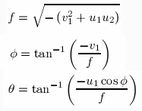
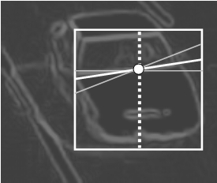
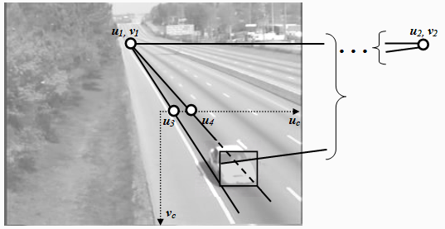
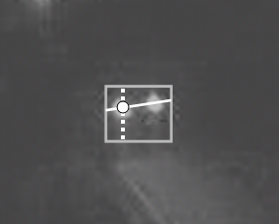
Automatic calibration algorithm

Slide 20
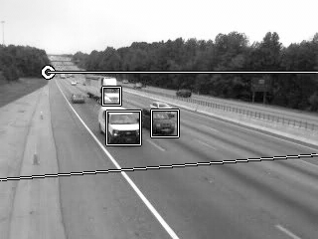
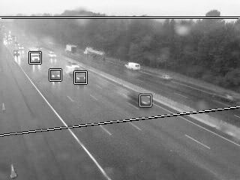
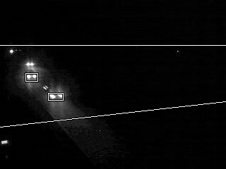
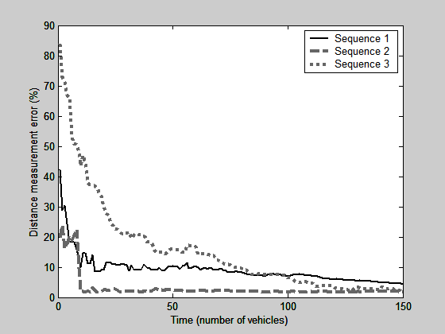
Results for automatic camera calibration

Slide 21
Let’s see a demo
Notes:
Show motorcycle video too.

Slide 22
Conclusion
A real-time system for detection, tracking and classification of vehicles
Automatic camera calibration for PTZ cameras which eliminates the need of manually setting up the detection zones
Pattern recognition helps eliminate false alarms caused by shadows and headlight reflections
Can easily incorporate additional knowledge to improve calibration accuracy
Quick setup for short term data collection applications
Notes:
Add portable tripod picture in conclusion (portable tripod and short-term data collection applications)

Slide 23
Future work
Extend the calibration algorithm to use lane markings when available for faster convergence of parameters
Develop an on-line learning algorithm which will incrementally “tune” the system for better detection rate at given location
Evaluate the system at a TMC for long-term performance
Extend classification to four classes
Handle intersections (including turn-counts)
Notes:
Add portable tripod picture in conclusion (portable tripod and short-term data collection applications)

Slide 24
Thank you

